Slide 1
Mob Programming
My first team

Slide 2


Thank you Hunter

Slide 3
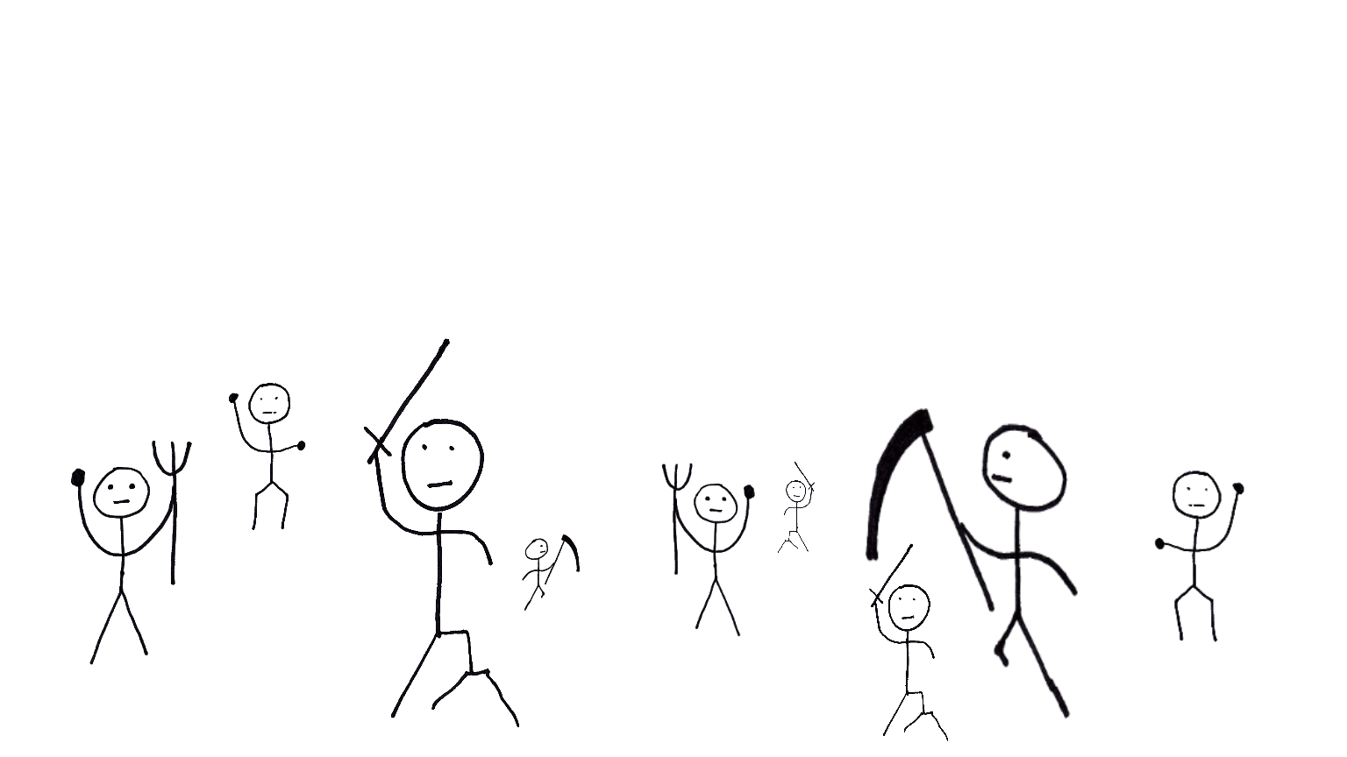
What is Mob-Programming?
All the people
working together
working
on the same thing,
on the same computer

Slide 4
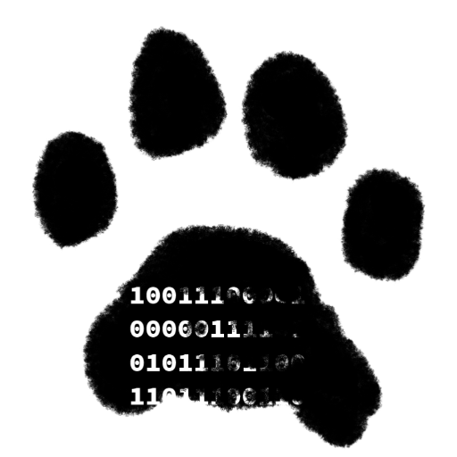
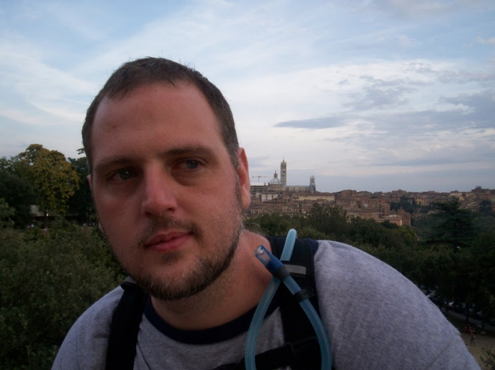
Who am I?
R. Jason Kerney
Lover of Code
Newer member
Agilest
Legacy Code Wizard
Mob Programmer
@JasonKerney

Slide 5
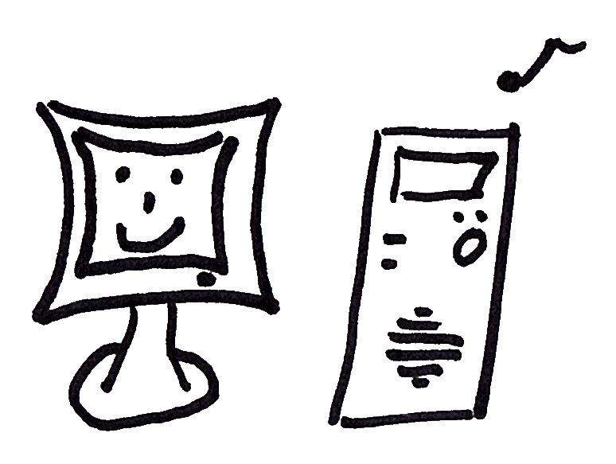
Overview

Slide 6
How we became a mob

Slide 7
Why we are a mob?
Because we want to be.

Slide 8

Rules
Show Kindness
Show Consideration
Show Respect
… At all Times

Slide 9
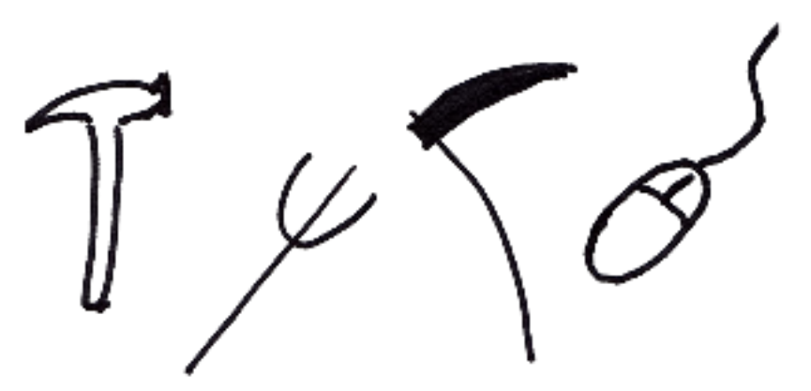
Tools
Tools

Slide 10
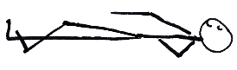
Guidelines

Slide 11
Guidelines
The Timer

Slide 12
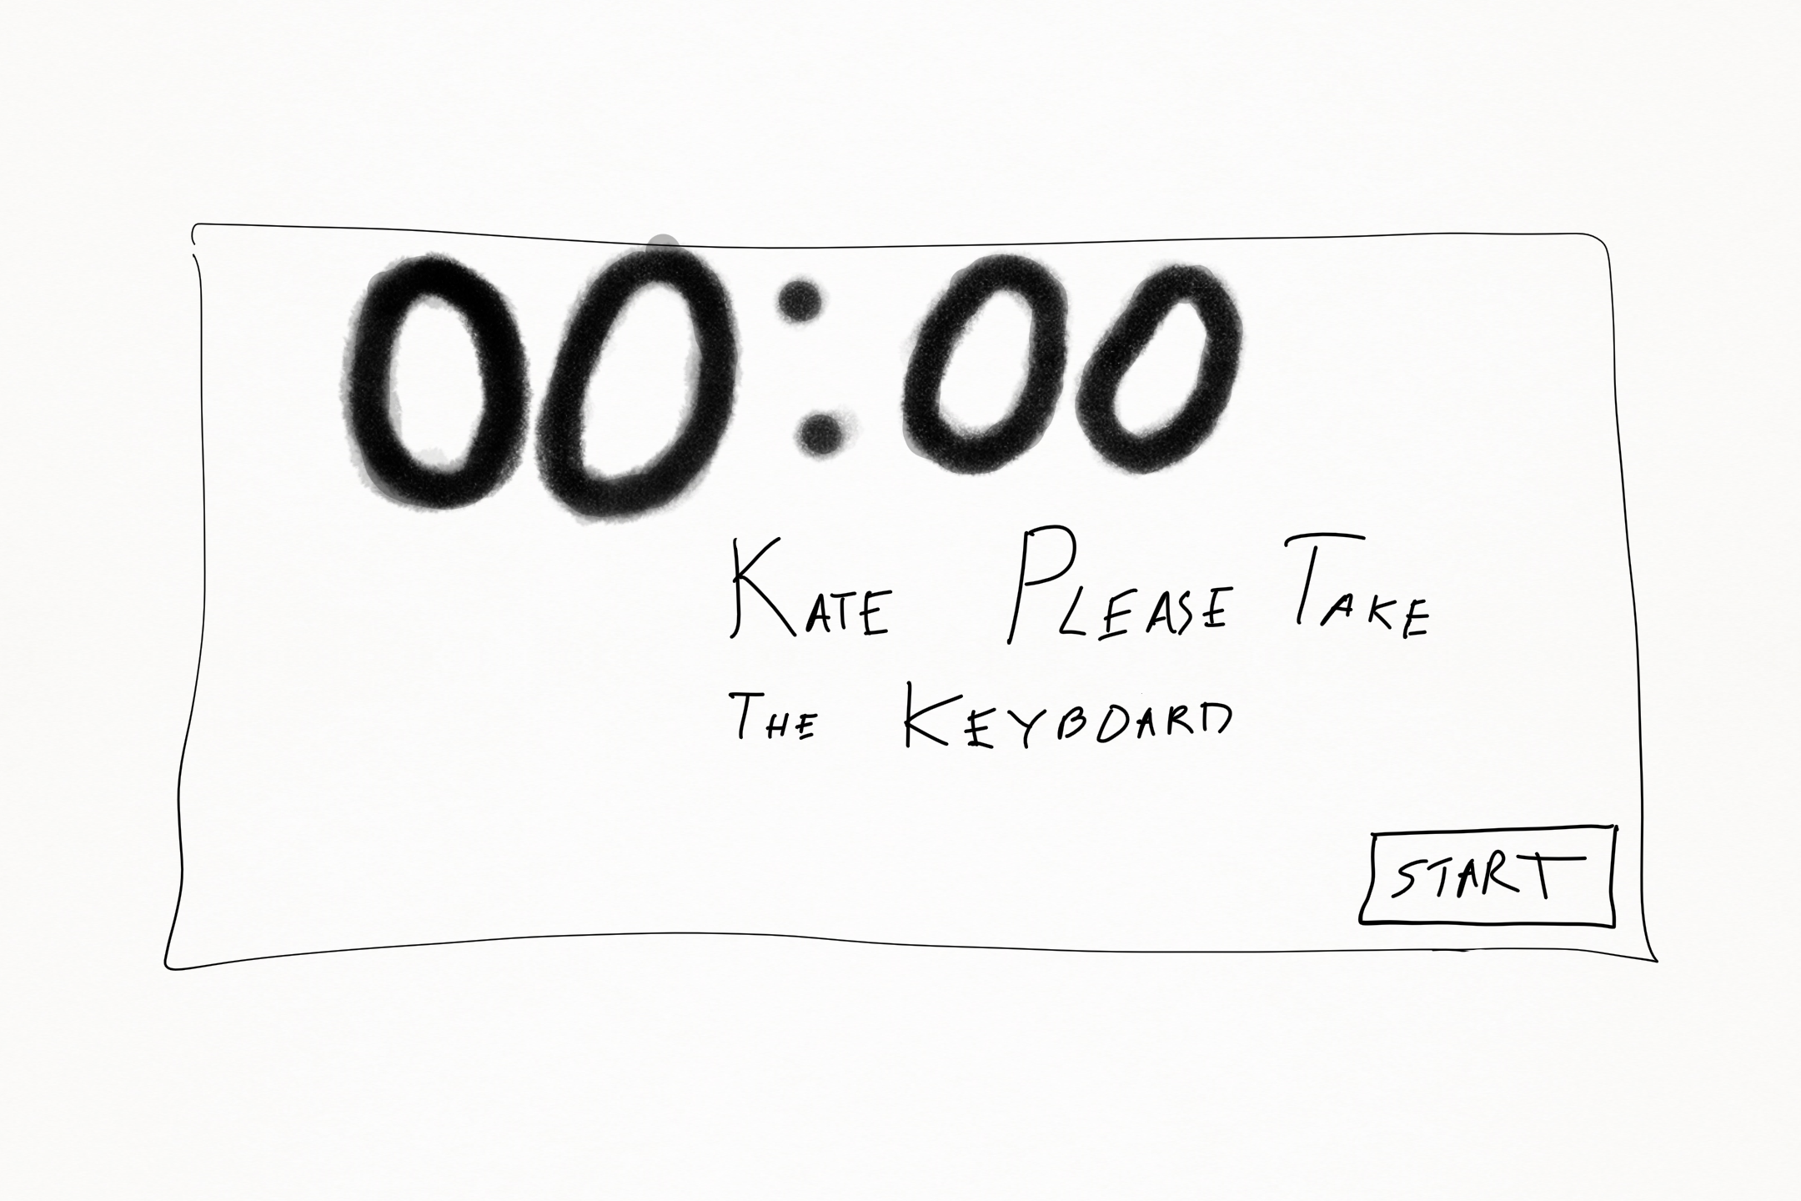

Slide 13
Guidelines
The Timer

Slide 14
Guidelines
The Timer
Driver Navigators

Slide 15
Guidelines
The Timer
Driver Navigators
Study Sessions

Slide 16
Guidelines
The Timer
Driver Navigators
Study Sessions
Automation

Slide 17
Guidelines
The Timer
Driver Navigators
Study Sessions
Automation
Guests / Visitors

Slide 18
Guidelines
The Timer
Driver Navigators
Study Sessions
Automation
Guests / Visitors
Retrospect

Slide 19
Guidelines
The Timer
Driver Navigators
Study Sessions
Automation
Guests / Visitors
Retrospect

Slide 20
Interviewing

Slide 21






Learning as a team

Slide 22
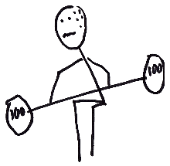
I Struggled

Slide 23
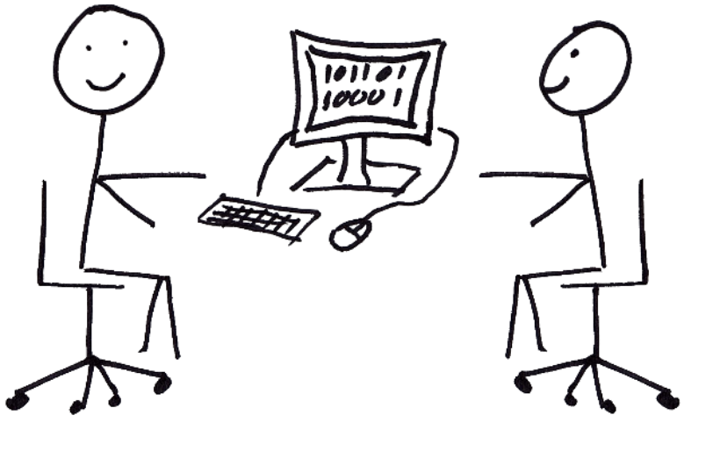
Not Advanced Pair Programming

Slide 24
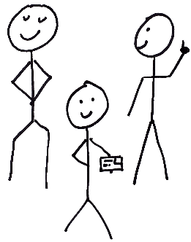
Real Team Work

Slide 25
Real Team Work
Different Points of View
Support Structures

Slide 26
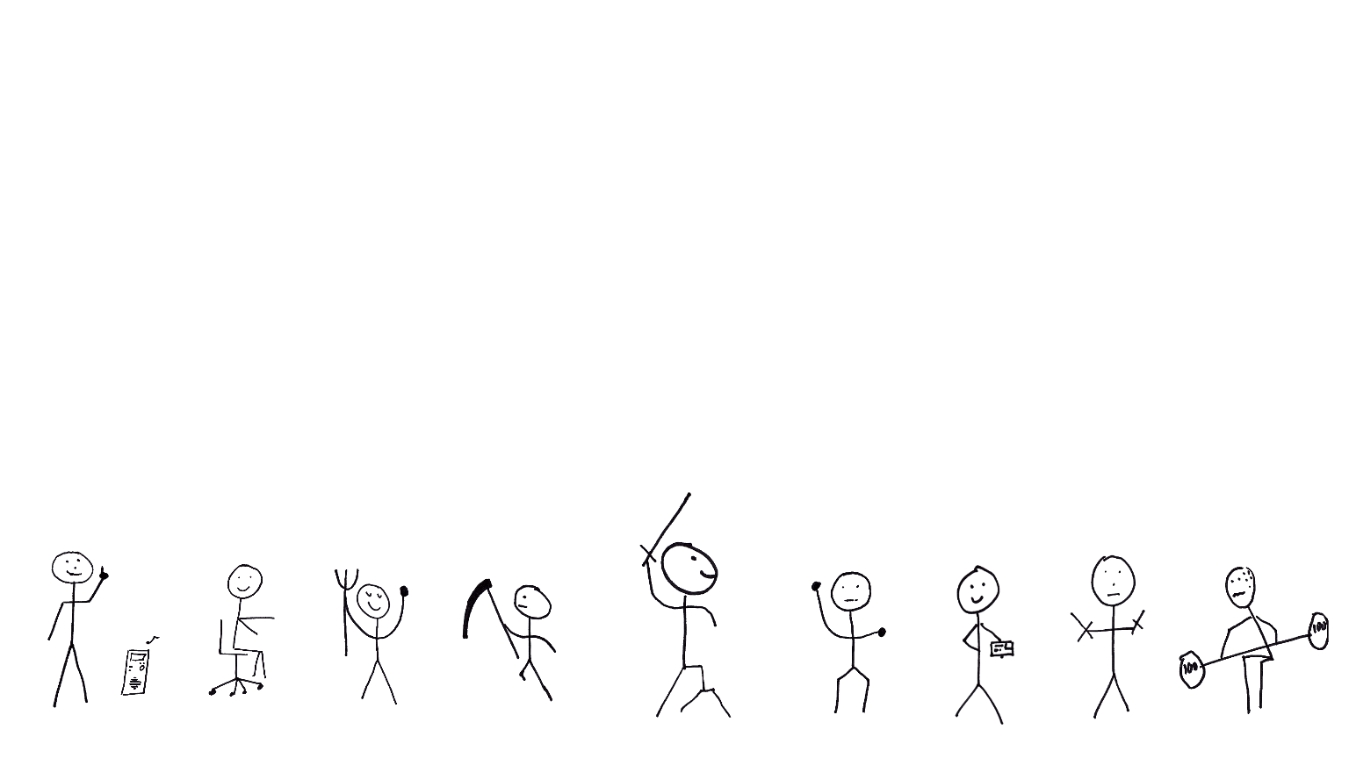
The Perfect Mob…

Slide 27
A Personal Note

Slide 28
Acknowledgements
Woody Zuill
Llewellyn Falco
Woody Zuill

Slide 29
How to Find me
@JasonKerney
Jason+Mob@teamkerney.com
bit.ly/rjkBlog
bit.ly/rjkGitHub
bit.ly/rjkIn
The Paper:
bit.ly/rjkFirstTeam

